Slide 4
By- Abhinesh sir
USE CODE FOR DISCOUNT : Y433
What is the value of modulation index for AM wave if amplitude of modulating signal is 0.8 V and carrier amplitude is 2 V?
(a) 0.2
(b) 0.4
(c) 0.5
(d) 0.6
Q

Slide 5
By- Abhinesh sir
USE CODE FOR DISCOUNT : Y433
Which of the following element is absent in an active filter?
(a) Resistor
(b) Inductor
(c) Capacitor
(d) Both resistor and capacitor
Q

Slide 6
By- Abhinesh sir
USE CODE FOR DISCOUNT : Y433
Calculate the total number of loop equations of an electrical network with 12 branches and 8 nodes.
(a) 4
(b) 3
(c) 6
(d) none
Q

Slide 7
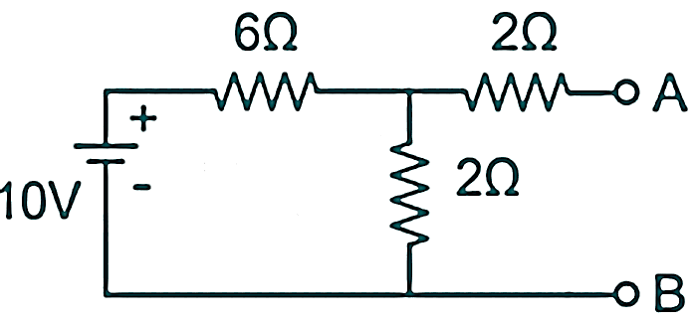
By- Abhinesh sir
USE CODE FOR DISCOUNT : Y433
Calculate the Norton equivalent between A and B for the following circuit.
(a) 2 A and 2 Ohms
(b) 0.71 A and 3.5 Ohms
(c) 2.5 A and 1 Ohms
(d) 1 A and 2 Ohms
Q

Slide 8
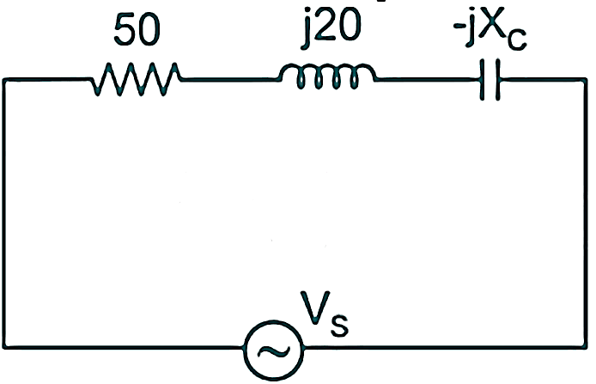
By- Abhinesh sir
USE CODE FOR DISCOUNT : Y433
Calculate the capacitive reactance (in ohms) at resonance for the given circuit.
(a) 10
(b) 20
(c) 30
(d) 40
Q

Slide 9
By- Abhinesh sir
USE CODE FOR DISCOUNT : Y433
The inductor follows the ____________.
(a) De-Morgan’s theorem.
(b) Fleming’s left – hand rule.
(c) Fleming’s right – hand rule.
(d) Lenz law.
Q

Slide 10
By- Abhinesh sir
USE CODE FOR DISCOUNT : Y433
When two resistors of same value are connected in a series with a third resistance of the same value as the other two, then what will be the net effective resistance?
(a) Net resistance decreases
(b) Net resistance increases
(c) Net resistance is doubled
(d) Net resistance is tripled
Q

Slide 11
By- Abhinesh sir
USE CODE FOR DISCOUNT : Y433
The varactor diode is used as a ____________.
(a) constant current source.
(b) constant voltage source.
(c) voltage – controlled capacitor.
(d) voltage multiplier.
Q

Slide 12
By- Abhinesh sir
USE CODE FOR DISCOUNT : Y433
What is the order of reverse current in a silicon diode?
(a) kA
(b) A
(c) mA
(d) nA
Q

Slide 13
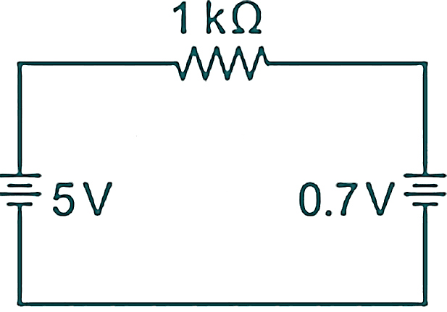
By- Abhinesh sir
USE CODE FOR DISCOUNT : Y433
What is the current (in mA) in the circuit given below assuming the second approximation of the silicon PN junction diode?
(a) 1.3
(b) 2.3
(c) 3.3
(d) 4.3
Q

Slide 14
By- Abhinesh sir
USE CODE FOR DISCOUNT : Y433
Choose the correct statement for the breakdown voltage of the Zener diode.
(a) It damages the diode.
(b) It decreases with a decrease in current.
(c) It is approximately constant.
(d) It is double the forward knee voltage.
Q

Slide 15
By- Abhinesh sir
USE CODE FOR DISCOUNT : Y433
The gate voltage of E-MOSFET is reduced to zero. Then the drain current is ___________.
(a) at saturation
(b) equal to $I_{DSS}$
(c) zero
(d) narrowing the channel
Q

Slide 16
By- Abhinesh sir
USE CODE FOR DISCOUNT : Y433
The transistor bias circuit arrangement providing a stable system using negative feedback from the collector to the base is ____________.
(a) collector to base bias.
(b) emitter bias.
(c) fixed bias.
(d) fixed bias with emitter resistor.
Q

Slide 17
By- Abhinesh sir
USE CODE FOR DISCOUNT : Y433
Which among the following is a limitation of KCL?
(a) It is not applicable for more than one voltage source.
(b) It is not applicable for circuits having more than two branches.
(c) It does not consider the dependent sources.
(d) It does not consider the leakage charge through nodes and conductor.
Q

Slide 18
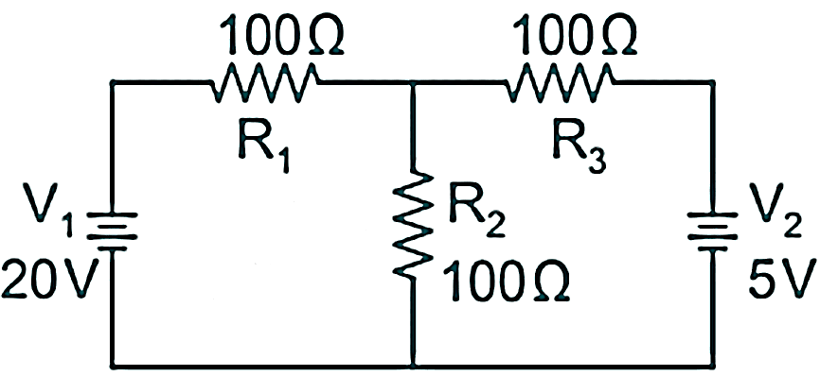
By- Abhinesh sir
USE CODE FOR DISCOUNT : Y433
What is the current (in mA) in resistor R₂ in the circuit given below?
(a) 73.4
(b) 83.4
(c) 93.4
(d) 103.4
Q

Slide 19
By- Abhinesh sir
USE CODE FOR DISCOUNT : Y433
What is the power transmitted to a load of 20 ohms by a voltage source of 20 V having an internal resistance of 60 Ohms?
(a) 0.50 W
(b) 0.75 W
(c) 1.00 W
(d) 1.25 W
Q

Slide 20
By- Abhinesh sir
USE CODE FOR DISCOUNT : Y433
A series RLC circuit has a resistance of 2 k-ohms, inductance of 0.05 H, and capacitance of 10 $μ$F. What is the bandwidth (in kHz) of the circuit?
(a) 5.86
(b) 6
(c) 6.36
(d) 7
Q

Slide 22
By- Abhinesh sir
USE CODE FOR DISCOUNT : Y433
A series RLC circuit has a resistance of 80 ohms, inductance of 1.25 H, and capacitance of 5 $μ$F. What is the quality factor of the circuit?
(a) 5.25
(b) 5.5
(c) 5.75
(d) 6.25
Q

Slide 23
By- Abhinesh sir
USE CODE FOR DISCOUNT : Y433
If the input resistor of 100 k-ohms of a binary – weighted DAC is connected to a 3 V supply, then what will be the current following through the resistor?
(a) 30 $μ$A
(b) 300 $μ$A
(c) 3 mA
(d) 30 mA
Q

Slide 24
By- Abhinesh sir
USE CODE FOR DISCOUNT : Y433
What is the output for the network given below?
(a) X = ((A + B) C) D
(b) X = (A + B) (C + D)
(c) X = A + (B + (CD))
(d) X = ((AB) + C) + D)
Q

Slide 25
By- Abhinesh sir
USE CODE FOR DISCOUNT : Y433
An 8 to 1 MUX has ____________ selection lines.
(a) 0
(b) 1
(c) 2
(d) 3
Q

Slide 26
By- Abhinesh sir
USE CODE FOR DISCOUNT : Y433
Susceptance is a measure of ability to pass __________.
(a) voltage
(b) current
(c) voltage and current
(d) None of these
Q

Slide 27
By- Abhinesh sir
USE CODE FOR DISCOUNT : Y433
Under which condition, a circuit is said to be in resonance?
(a) Current is in phase with the applied voltage
(b) Current is out of phase with the applied voltage
(c) Current is 45 degree out of phase with the applied voltage
(d) Current is 90 degree out of phase with the applied voltage
Q

Slide 28
By- Abhinesh sir
USE CODE FOR DISCOUNT : Y433
The process of converting the Analog sample into discrete form is called _____________.
(a) modulation
(b) demultiplexing
(c) sampling
(d) quatization
Q

Slide 29
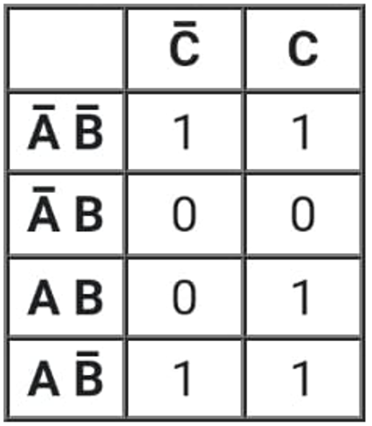
By- Abhinesh sir
USE CODE FOR DISCOUNT : Y433
What is the simplest expression for K-map shown in the figure given below?

