Slide 1
13

Slide 3
SSC JE Mechanical Previous Year Questions + Answers | Mechanical Engineering
Mechanical Engineering
Q. If the compression or expansion of a gas takes place in such a way that the gas neither gives heat nor takes heat from its surroundings, the process is said to be !
A. Isothermal
B. Adiabatic
C. Isobaric
D. Isolated
For 78% Discount
Use Code : “Y166”
78% Discount Y166
Join Our Paid Batch : SSC JE Batch | Mahapack Batch | Use Code Y166 For 78% of Discount

Slide 4
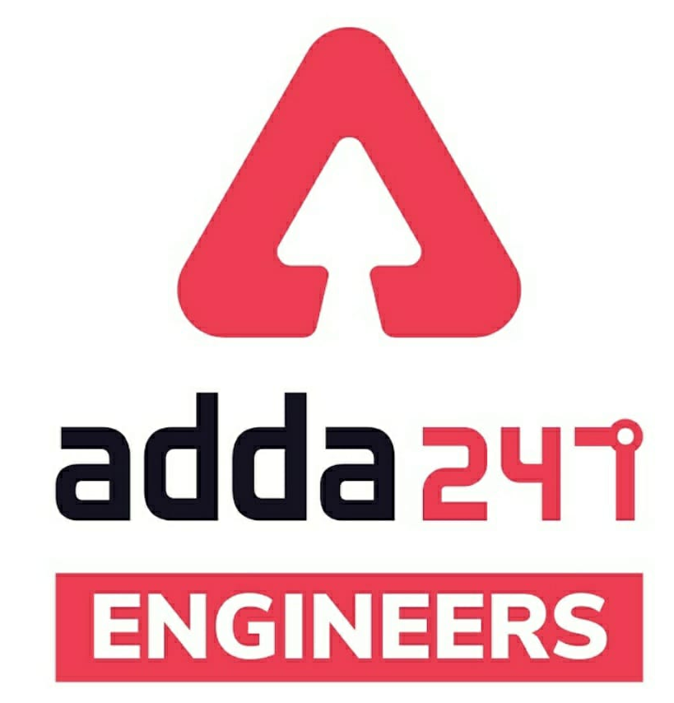
SSC JE Mechanical Previous Year Questions + Answers | Mechanical Engineering
Mechanical Soormas
Pragya Srivastava
Last Bencher
Subir
Piyush Mechanical
Lokesh Varwan
Mr Dilip Gupta
Amarjyoti
Ritick Konwar
Ravi Raj
Anchal Mishra
Yogi Tomar
MS D2E
Anuj Kanoujiya
Vijay Kumar
Nanadan Mehta
Amit Kumar
Sahil Kumar
Sandeep Kumar Jha
Eshika Rajak
Nitin Mandaokar
Shivani Singh
Vishnu Vardhan
Ashutosh Kant
Kunal Kisku
Lunavath Rajesh
Ajay Kumar
Sonakshi Pulast
Entertainment Vlog
for
Code : “Y166”

Slide 5
SSC JE Mechanical Previous Year Questions + Answers | Mechanical Engineering
Mechanical Soormas
Anup Kumar Sarkar
Rahul Kumar
Garima Shukla
Shiksha Aur Vikas
Raj Yadav
Vikas Dev Pandey
Yash Menariya
Rajat Bobade
Manadeep
Kuldeet Das
Rajesh Rohila
Deepak Yadav
Sky
Pawan Singh Rana
Ajaya Suna
Jannatul Siddiqui
Abhishek Gupta
Pankaj Mahato
Anil Gola
Avadhesh Yadav
Aman Kumar
Akhilesh Gupta
for
Code : “Y166”

Slide 6
SSC JE Mechanical Previous Year Questions + Answers | Mechanical Engineering
Mechanical Engineering
For 78% Discount
Use Code : “Y166”
78% Discount Y166
Join Our Paid Batch : SSC JE Batch | Mahapack Batch | Use Code Y166 For 78% of Discount

Slide 7
SSC JE Mechanical Previous Year Questions + Answers | Mechanical Engineering
Mechanical Engineering
Q. A system is taken from state A to state B along two different paths 1 and 2. The heat absorbed and work done by the system along these paths are Q1 and Q2 and W1 and W2 respectively, then!
A. Q1 = Q2
B. W1 + Q1 = Q2 + W2
C. W1 = W2
D. Q1 – W1 = Q2 – W2
UKPSC AE 2012 Paper–II
For 78% Discount
Use Code : “Y166”
78% Discount Y166
Join Our Paid Batch : SSC JE Batch | Mahapack Batch | Use Code Y166 For 78% of Discount

Slide 8
SSC JE Mechanical Previous Year Questions + Answers | Mechanical Engineering
Mechanical Engineering
Q. Which of the following devices complies with the Clausius statement of the second law of thermodynamics!?
A. Closed-cycle gas turbine
B. Internal combustion engine
C. Steam power plant
D. Milk chilling plant
For 78% Discount
Use Code : “Y166”
78% Discount Y166
Join Our Paid Batch : SSC JE Batch | Mahapack Batch | Use Code Y166 For 78% of Discount

Slide 9
SSC JE Mechanical Previous Year Questions + Answers | Mechanical Engineering
Mechanical Engineering
Q. The area of a p-v diagram for a Carnot cycle represents_
A. Heat supplied
B. Heat rejected
C. Work done
D. Temperature drop
UPPSC AE 12.04.2016 Paper-II
TPSC AE 2015
For 78% Discount
Use Code : “Y166”
78% Discount Y166
Join Our Paid Batch : SSC JE Batch | Mahapack Batch | Use Code Y166 For 78% of Discount

Slide 10
SSC JE Mechanical Previous Year Questions + Answers | Mechanical Engineering
Mechanical Engineering
Q. Carnot cycle consists of !
A. Two Isochoric & two isentropic processes
B. Two isothermal and two isenthalpic processes
C. Two constant pressure and two isentropic processes
D. none of the above
For 78% Discount
Use Code : “Y166”
78% Discount Y166
Join Our Paid Batch : SSC JE Batch | Mahapack Batch | Use Code Y166 For 78% of Discount

Slide 11
SSC JE Mechanical Previous Year Questions + Answers | Mechanical Engineering
Mechanical Engineering
Q. Three centrifugal pumps having rate of 240 litre in one hour are connected in straight line having H1,H2,H3 as 5 mt, 5 mt, and 10mt. then its discharge will become (litre/min)!
230
240
120
none
For 78% Discount
Use Code : “Y166”
78% Discount Y166
Join Our Paid Batch : SSC JE Batch | Mahapack Batch | Use Code Y166 For 78% of Discount

Slide 12
SSC JE Mechanical Previous Year Questions + Answers | Mechanical Engineering
Mechanical Engineering
Q. Vishal is working in Refrigeration plant where he found that the plant is consuming 630KJ of energy to produce 2TR of refrigeration effect. If the refrigeration plant is working on VCRS then what will be the compressor work in KJ-
90 KJ
630 KJ
750 KJ
250 KJ
For 78% Discount
Use Code : “Y166”
78% Discount Y166
Join Our Paid Batch : SSC JE Batch | Mahapack Batch | Use Code Y166 For 78% of Discount

Slide 13
SSC JE Mechanical Previous Year Questions + Answers | Mechanical Engineering
Mechanical Engineering
Q. On the basis of thermodynamics in any Static process which of the parameter can be seen_
Workdone
Heat transfer
Enthalpy
None
For 78% Discount
Use Code : “Y166”
78% Discount Y166
Join Our Paid Batch : SSC JE Batch | Mahapack Batch | Use Code Y166 For 78% of Discount

Slide 14
SSC JE Mechanical Previous Year Questions + Answers | Mechanical Engineering
Mechanical Engineering
Q. A system is having 250KJ of internal energy at 50 degree Kelvin. In the period of 6 hours its internal energy became 100KJ then the Least unavailable energy will be_!
250KJ
350KJ
100KJ
150KJ
For 78% Discount
Use Code : “Y166”
78% Discount Y166
Join Our Paid Batch : SSC JE Batch | Mahapack Batch | Use Code Y166 For 78% of Discount

Slide 15
78% Discount Y166
Join Our Paid Batch : SSC JE Batch | Mahapack Batch | Use Code Y166 For 78% of Discount

Slide 16
78% Discount Y166
Join Our Paid Batch : SSC JE Batch | Mahapack Batch | Use Code Y166 For 78% of Discount

Slide 17
SSC JE Mechanical Previous Year Questions + Answers | Mechanical Engineering
Mechanical Engineering
Q. A 5 TR refrigeration capacity refrigerator is 50% efficient what will be amount of energy input-
3.5KW
35KW
50KW
5KW
For 78% Discount
Use Code : “Y166”
78% Discount Y166
Join Our Paid Batch : SSC JE Batch | Mahapack Batch | Use Code Y166 For 78% of Discount

Slide 18
SSC JE Mechanical Previous Year Questions + Answers | Mechanical Engineering
Mechanical Engineering
Q. The Dry ice is produced by_
A. Drying the ice
B. Keeping ice in an insulated chamber
C. By solidifying liquid CO₂
D. None of these
For 78% Discount
Use Code : “Y166”
78% Discount Y166
Join Our Paid Batch : SSC JE Batch | Mahapack Batch | Use Code Y166 For 78% of Discount

Slide 19
SSC JE Mechanical Previous Year Questions + Answers | Mechanical Engineering
Mechanical Engineering
Q. On a Psychrometric chart, sensible cooling is represented by.
A. Horizontal line
B. Inclined line
C. Vertical line
D. None of these
For 78% Discount
Use Code : “Y166”
78% Discount Y166
Join Our Paid Batch : SSC JE Batch | Mahapack Batch | Use Code Y166 For 78% of Discount

Slide 20
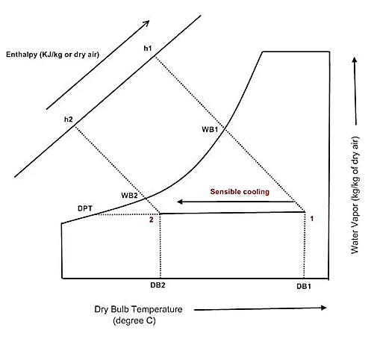
SSC JE Mechanical Previous Year Questions + Answers | Mechanical Engineering
Mechanical Engineering
For 78% Discount
Use Code : “Y166”
78% Discount Y166
Join Our Paid Batch : SSC JE Batch | Mahapack Batch | Use Code Y166 For 78% of Discount

Slide 21
SSC JE Mechanical Previous Year Questions + Answers | Mechanical Engineering
Mechanical Engineering
Q. On a Psychrometric chart, sensible cooling is represented by.
A. Horizontal line
B. Inclined line
C. Vertical line
D. None of these
For 78% Discount
Use Code : “Y166”
78% Discount Y166
Join Our Paid Batch : SSC JE Batch | Mahapack Batch | Use Code Y166 For 78% of Discount

Slide 22
SSC JE Mechanical Previous Year Questions + Answers | Mechanical Engineering
Mechanical Engineering
Q. By what process, maximum hardness is obtained for a steel part-?
A. Carburizing
B. Nitriding
C. Cyaniding
D. Annealing
For 78% Discount
Use Code : “Y166”
78% Discount Y166
Join Our Paid Batch : SSC JE Batch | Mahapack Batch | Use Code Y166 For 78% of Discount

Slide 23
SSC JE Mechanical Previous Year Questions + Answers | Mechanical Engineering
Mechanical Engineering
Q. Collapsible tubes are made by_
A. Drawing
B. Spinning
C. Extrusion
D. Rolling
For 78% Discount
Use Code : “Y166”
78% Discount Y166
Join Our Paid Batch : SSC JE Batch | Mahapack Batch | Use Code Y166 For 78% of Discount

Slide 24
SSC JE Mechanical Previous Year Questions + Answers | Mechanical Engineering
Mechanical Engineering
Q. Wrinkling is a common defect found in-
A. Bend components
B. Deep drawn components
C. Embossed components
D. Blanked components
For 78% Discount
Use Code : “Y166”
78% Discount Y166
Join Our Paid Batch : SSC JE Batch | Mahapack Batch | Use Code Y166 For 78% of Discount

Slide 25
SSC JE Mechanical Previous Year Questions + Answers | Mechanical Engineering
Mechanical Engineering
Q. The crystal structure of brass is-
A. BCC
B. FCC
C. HCP
D. Orthorhombic
For 78% Discount
Use Code : “Y166”
78% Discount Y166
Join Our Paid Batch : SSC JE Batch | Mahapack Batch | Use Code Y166 For 78% of Discount

Slide 26
SSC JE Mechanical Previous Year Questions + Answers | Mechanical Engineering
Mechanical Engineering
Q. The property which enables metals to be drawn into wire is known as-
A. Malleability
B. Ductility
C. Straining
D. Plastic deformation
For 78% Discount
Use Code : “Y166”
78% Discount Y166
Join Our Paid Batch : SSC JE Batch | Mahapack Batch | Use Code Y166 For 78% of Discount

Slide 27
SSC JE Mechanical Previous Year Questions + Answers | Mechanical Engineering
Mechanical Engineering
Q. The spring constant of Helical Compression Spring does not depend on-
A. Coil Diameter
B. Material Strength
C. Number of active turns
D. Wire diameter
For 78% Discount
Use Code : “Y166”
78% Discount Y166
Join Our Paid Batch : SSC JE Batch | Mahapack Batch | Use Code Y166 For 78% of Discount

Slide 28
SSC JE Mechanical Previous Year Questions + Answers | Mechanical Engineering
Mechanical Engineering
For 78% Discount
Use Code : “Y166”
78% Discount Y166
Join Our Paid Batch : SSC JE Batch | Mahapack Batch | Use Code Y166 For 78% of Discount

Slide 29
SSC JE Mechanical Previous Year Questions + Answers | Mechanical Engineering
Mechanical Engineering
Q. The spring constant of Helical Compression Spring does not depend on-
A. Coil Diameter
B. Material Strength
C. Number of active turns
D. Wire diameter
For 78% Discount
Use Code : “Y166”
78% Discount Y166
Join Our Paid Batch : SSC JE Batch | Mahapack Batch | Use Code Y166 For 78% of Discount

Slide 30
SSC JE Mechanical Previous Year Questions + Answers | Mechanical Engineering
Mechanical Engineering
Q. Maximum shear stress in a Mohr's circle.
A. Is equal to the radius of Mohr's circle
B. Is greater than the radius of the Mohr's circle
C. Is less than the radius of the Mohr's circle
D. None of the above
For 78% Discount
Use Code : “Y166”
78% Discount Y166
Join Our Paid Batch : SSC JE Batch | Mahapack Batch | Use Code Y166 For 78% of Discount

Slide 31
Use Code “Y166” for
maximum 78%* discount
400+ Hours Two-way Interactive Live Classes.
Syllabus is based on Recent Notification, Previous Years Exam and the same will be updated accordingly.
Enroll in this Batch, Limited Seats available.
Recorded Videos available 24/7 for quick Revision.
Solve Unlimited doubts with experts.
Get Preparation tips from the experts & Learn Time Management.
Join Our Paid Batch : SSC JE Batch | Mahapack Batch | Use Code Y166 For 78% of Discount

Slide 32
78% Discount Y166
Join Our Paid Batch : SSC JE Batch | Mahapack Batch | Use Code Y166 For 78% of Discount

Slide 33
SSC JE Mechanical Previous Year Questions + Answers | Mechanical Engineering
Mechanical Engineering
HW. The rate of change of bending moment is equal to ______.
A. shear force at the section
B. deflection at the section
C. loading at that section
D. slope at that section
For 78% Discount
Use Code : “Y166”
78% Discount Y166
Join Our Paid Batch : SSC JE Batch | Mahapack Batch | Use Code Y166 For 78% of Discount

