Slide 1
SSC JE Mechanical Previous Year Questions + Answers | Mechanical Engineering
Mechanical Engineering
Q.Which of the following is reason of irreversibility!?
A. Lack of equilibrium during the process
B. involvement of dissipative effects
C. None of the above
D. both a & b
For 78% Discount
Use Code : “Y166”
78% Discount Y166
7
Join Our Paid Batch : SSC JE Batch | Mahapack Batch | Use Code Y166 For 78% of Discount

Slide 3
1000Qs For All AE/JE Exams | Mechanical Engg | Questions + Answer
Mechanical Engineering
HW. The magnitude of linear velocity of a point B on link AB relative to point A is w = angular velocity of link AB.
A. w.AB
B. w.(AB)²
C. w².AB
D. (w.AB)²
For 78% Discount
Use Code : “Y166”
78% Discount Y166
Mentor : Shivam Gupta
For Complete theory and concepts join our Mahapack Batch, Use Code Y166 For 78% of Discount

Slide 4
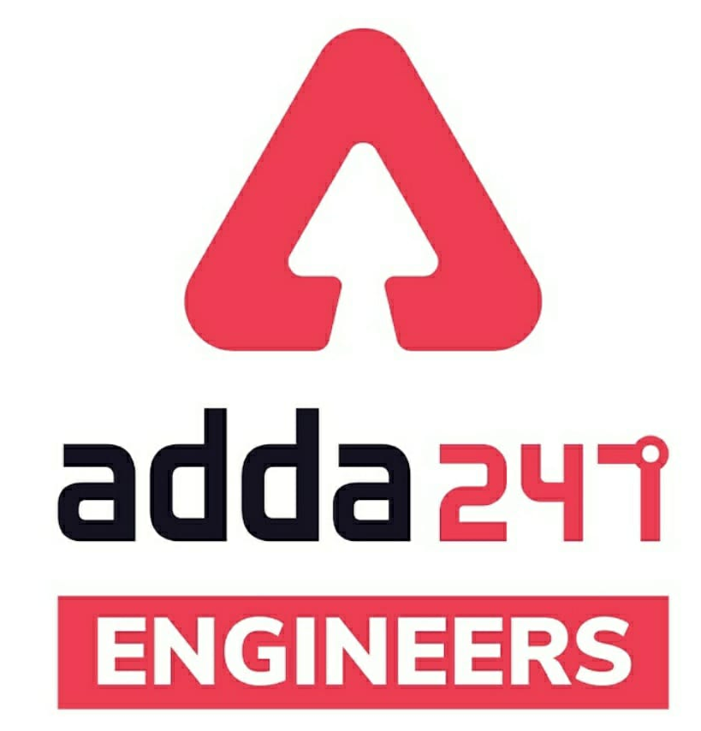
SSC JE Mechanical Previous Year Questions + Answers | Mechanical Engineering
Mechanical Soormas
Subir
Lokesh Varwan
Dilip Gupta
Ramen Ghosh
Cycle Raja
Pankaj Mahato
Shiksha Aur Vikas
Pragya Srivastava
Rahul Kumar
Shivani Singh
Atit Ramteke
Warif
Sahil Kumar
Anchal Mishra
Sanjit Jana
MS D2E
Mechanical Queen
Piyush Mechanical
Aashik Hussain
Amit Kumar
Pannelal Kushwaha
Gurdeep Singh
Shri Krishna
Vikas Dev Pandey
Jitendra Kumar
Ajay Kumar
Pawan Singh Rana
Nandan Mehta
for
Code : “Y166”

Slide 5
SSC JE Mechanical Previous Year Questions + Answers | Mechanical Engineering
Mechanical Soormas
Rajat Bobde
Raj Yadav
Om Prakash Chaurasiya
Narender Sura
Anuj Kanoujiya
Somnath Das
Ajit Potbhare
for
Code : “Y166”

Slide 6
SSC JE Mechanical Previous Year Questions + Answers | Mechanical Engineering
Mechanical Engineering
For 78% Discount
Use Code : “Y166”
78% Discount Y166
Join Our Paid Batch : SSC JE Batch | Mahapack Batch | Use Code Y166 For 78% of Discount

Slide 7
1000Qs For All AE/JE Exams | Mechanical Engg | Questions + Answer
Mechanical Engineering
Q. Minor losses in a pipe flow are those losses!
A. Which are insignificantly small
B. Which can be neglected always
C. Caused by frictional resistance
D. Caused by local disturbance due to pipe fitting
For 78% Discount
Use Code : “Y166”
78% Discount Y166
Mentor : Shivam Gupta
For Complete theory and concepts join our Mahapack Batch, Use Code Y166 For 78% of Discount

Slide 8
1000Qs For All AE/JE Exams | Mechanical Engg | Questions + Answer
Mechanical Engineering
Q. Maximum impulse will be developed in hydraulic ram when!
A. Ram chamber is large
B. Supply pipe is long
C. Supply pipe is short
D. Waste valve closes suddenly
For 78% Discount
Use Code : “Y166”
78% Discount Y166
Mentor : Shivam Gupta
For Complete theory and concepts join our Mahapack Batch, Use Code Y166 For 78% of Discount

Slide 9
1000Qs For All AE/JE Exams | Mechanical Engg | Questions + Answer
Mechanical Engineering
Q. A hydraulic intensifier normally consists of !
A. a cylinder and a ram
B. a cylinder, a piston, storage tank and control valve
C. two cylinders, two rams and a storage device
D. two co-axial rams and two cylinders
For 78% Discount
Use Code : “Y166”
78% Discount Y166
Mentor : Shivam Gupta
For Complete theory and concepts join our Mahapack Batch, Use Code Y166 For 78% of Discount

Slide 10
1000Qs For All AE/JE Exams | Mechanical Engg | Questions + Answer
Mechanical Engineering
Q. Which of the following devices is used for transmitting increased or decreased torque from one shaft to another.
A. Hydraulic torque converter
B. Hydraulic ram
C. Hydraulic intensifier
D. Hydraulic coupling
For 78% Discount
Use Code : “Y166”
78% Discount Y166
Mentor : Shivam Gupta
For Complete theory and concepts join our Mahapack Batch, Use Code Y166 For 78% of Discount

Slide 11
1000Qs For All AE/JE Exams | Mechanical Engg | Questions + Answer
Mechanical Engineering
Q. Specific speed of an Pelton wheel ranges from.
A. 12 to 70
B. 80 to 400
C. 300 to 1000
D. 1000 to 1200
For 78% Discount
Use Code : “Y166”
78% Discount Y166
Mentor : Shivam Gupta
For Complete theory and concepts join our Mahapack Batch, Use Code Y166 For 78% of Discount

Slide 12
1000Qs For All AE/JE Exams | Mechanical Engg | Questions + Answer
Mechanical Engineering
Q. The value of speed ratio (K_{u}) in case of Francis turbine ranges from-
A. 0.2 to 0.3
B. 0.4 to 0.5
C. 0.6 to 0.9
D. none of above
For 78% Discount
Use Code : “Y166”
78% Discount Y166
Mentor : Shivam Gupta
For Complete theory and concepts join our Mahapack Batch, Use Code Y166 For 78% of Discount

Slide 13
1000Qs For All AE/JE Exams | Mechanical Engg | Questions + Answer
Mechanical Engineering
Q. A Palton turbine is considered suitable for which of the following head !
A. 10 to 20 m
B. 20 to 30 m
C. 35 to 50 m
D. 100 to 250 m
For 78% Discount
Use Code : “Y166”
78% Discount Y166
Mentor : Shivam Gupta
For Complete theory and concepts join our Mahapack Batch, Use Code Y166 For 78% of Discount

Slide 14
1000Qs For All AE/JE Exams | Mechanical Engg | Questions + Answer
Mechanical Engineering
Q. Kaplan turbine is.
A. A axial flow turbine
B. A high head mixed flow turbine
C. An impulse inward flow turbine
D. An outward flow reaction turbine
For 78% Discount
Use Code : “Y166”
78% Discount Y166
Mentor : Shivam Gupta
For Complete theory and concepts join our Mahapack Batch, Use Code Y166 For 78% of Discount

Slide 15
1000Qs For All AE/JE Exams | Mechanical Engg | Questions + Answer
Mechanical Engineering
Q. Which of the following serious problems arise from cavitation !?
A. Damage to blade surface
B. Fall in efficiency
C. Noise and vibration
D. All of above
For 78% Discount
Use Code : “Y166”
78% Discount Y166
Mentor : Shivam Gupta
For Complete theory and concepts join our Mahapack Batch, Use Code Y166 For 78% of Discount

Slide 16
1000Qs For All AE/JE Exams | Mechanical Engg | Questions + Answer
Mechanical Engineering
Q. The blade of power saw is made of.
A. High speed steel
B. Baron steel
C. Stainless steel
D. Malleable cast iron
For 78% Discount
Use Code : “Y166”
78% Discount Y166
Mentor : Shivam Gupta
For Complete theory and concepts join our Mahapack Batch, Use Code Y166 For 78% of Discount

Slide 17
1000Qs For All AE/JE Exams | Mechanical Engg | Questions + Answer
Mechanical Engineering
Q. The most suitable theory of failure for brittle material is..
A. Maximum strain energy theory
B. Maximum normal stress theory
C. Maximum shear stress theory
D. Maximum distortion energy theory
For 78% Discount
Use Code : “Y166”
78% Discount Y166
Mentor : Shivam Gupta
For Complete theory and concepts join our Mahapack Batch, Use Code Y166 For 78% of Discount

Slide 18
1000Qs For All AE/JE Exams | Mechanical Engg | Questions + Answer
Mechanical Engineering
Q. A key connecting a flange coupling to a shaft is likely to fail in_
A. Tension
B. Bending
C. Shear
D. Torsion
For 78% Discount
Use Code : “Y166”
78% Discount Y166
Mentor : Shivam Gupta
For Complete theory and concepts join our Mahapack Batch, Use Code Y166 For 78% of Discount

Slide 19
1000Qs For All AE/JE Exams | Mechanical Engg | Questions + Answer
Mechanical Engineering
Q. An open coiled helical spring is subjected to an axial force, the wire of the spring is subjected to !
A. Combined shear and bending only
B. Combined shear, bending and twisting
C. Combined shear and twisting only
D. Direct shear only
For 78% Discount
Use Code : “Y166”
78% Discount Y166
Mentor : Shivam Gupta
For Complete theory and concepts join our Mahapack Batch, Use Code Y166 For 78% of Discount

Slide 20
1000Qs For All AE/JE Exams | Mechanical Engg | Questions + Answer
Mechanical Engineering
Q. The life of a ball bearing is inversely proportional to-
A. (Load)^{1/3}
B. (Load)³
C. (Load)^{3.3}
D. (Load)²
For 78% Discount
Use Code : “Y166”
78% Discount Y166
Mentor : Shivam Gupta
For Complete theory and concepts join our Mahapack Batch, Use Code Y166 For 78% of Discount

Slide 21
1000Qs For All AE/JE Exams | Mechanical Engg | Questions + Answer
Mechanical Engineering
Q. The Most suitable bearing for carrying very heavy loads with slow speed is .
A. Hydrostatic bearing
B. Hydrodynamic bearing
C. Ball bearing
D. Roller bearing
For 78% Discount
Use Code : “Y166”
78% Discount Y166
Mentor : Shivam Gupta
For Complete theory and concepts join our Mahapack Batch, Use Code Y166 For 78% of Discount

Slide 22
1000Qs For All AE/JE Exams | Mechanical Engg | Questions + Answer
Mechanical Engineering
Q. The bearing characteristic number in a hydrodynamic bearing depends on !
A. Length, Width and Load
B. Length, Width and speed
C. Viscosity, speed and Load
D. Viscosity, Speed and bearing pressure
For 78% Discount
Use Code : “Y166”
78% Discount Y166
Mentor : Shivam Gupta
For Complete theory and concepts join our Mahapack Batch, Use Code Y166 For 78% of Discount

Slide 24
1000Qs For All AE/JE Exams | Mechanical Engg | Questions + Answer
Mechanical Engineering
Q. In spur gears, the circle on which the involute is generated is called.
A. Base circle
B. Pitch circle
C. Clearance circle
D. Addendum circle
For 78% Discount
Use Code : “Y166”
78% Discount Y166
Mentor : Shivam Gupta
For Complete theory and concepts join our Mahapack Batch, Use Code Y166 For 78% of Discount

Slide 25
1000Qs For All AE/JE Exams | Mechanical Engg | Questions + Answer
Mechanical Engineering
Q. When the pitching of a ship is upward, the effect of gyroscopic couple acting on it will be .
A. To move the ship towards start-board
B. To move the ship towards port side
C. To raise the stern and lower the bow
D. To raise the bow and lower the stern
For 78% Discount
Use Code : “Y166”
78% Discount Y166
Mentor : Shivam Gupta
For Complete theory and concepts join our Mahapack Batch, Use Code Y166 For 78% of Discount

Slide 26
1000Qs For All AE/JE Exams | Mechanical Engg | Questions + Answer
Mechanical Engineering
Q. The partial balancing means -
A. Best balancing of engines
B. Balancing partially the reciprocating masses
C. Balancing partially the revolving masses
D. All of the above
For 78% Discount
Use Code : “Y166”
78% Discount Y166
Mentor : Shivam Gupta
For Complete theory and concepts join our Mahapack Batch, Use Code Y166 For 78% of Discount

Slide 27
1000Qs For All AE/JE Exams | Mechanical Engg | Questions + Answer
Mechanical Engineering
Q. In a clock mechanism, the gear train used to connect minute hand to hour hand is -
A. Epicyclic gear train
B. Reverted gear train
C. Compound gear train
D. Simple gear train
For 78% Discount
Use Code : “Y166”
78% Discount Y166
Mentor : Shivam Gupta
For Complete theory and concepts join our Mahapack Batch, Use Code Y166 For 78% of Discount

Slide 28
1000Qs For All AE/JE Exams | Mechanical Engg | Questions + Answer
Mechanical Engineering
Q. In a Hartnell governor, if a spring of greater stiffness is used, then the governor will be -
A. More sensitive
B. Less sensitive
C. Isochronous
D. none of above
For 78% Discount
Use Code : “Y166”
78% Discount Y166
Mentor : Shivam Gupta
For Complete theory and concepts join our Mahapack Batch, Use Code Y166 For 78% of Discount

Slide 29
1000Qs For All AE/JE Exams | Mechanical Engg | Questions + Answer
Mechanical Engineering
Q. The swaying couple is due to the_
A. Two cylinders of locomotive
B. Partial balancing
C. Primary unbalanced force
D. Secondary unbalanced force
For 77% Discount
Use Code : “Y166”
78% Discount Y166
Mentor : Shivam Gupta
For Complete theory and concepts join our Mahapack Batch, Use Code Y166 For 78% of Discount

Slide 30
1000Qs For All AE/JE Exams | Mechanical Engg | Questions + Answer
Mechanical Engineering
Q. The radial distance of a tooth from the pitch circle to the bottom of the tooth, is called .
A. Dedendum
B. Addendum
C. Clearance
D. Working depth
For 78% Discount
Use Code : “Y166”
78% Discount Y166
Mentor : Shivam Gupta
For Complete theory and concepts join our Mahapack Batch, Use Code Y166 For 78% of Discount

Slide 31
1000Qs For All AE/JE Exams | Mechanical Engg | Questions + Answer
Mechanical Engineering
Q. The work requirement for a reciprocating compressor is minimum when compression process is.
A. Isothermal
B. Isentropic
C. Polytropic
D. Adiabatic
For 78% Discount
Use Code : “Y166”
78% Discount Y166
Mentor : Shivam Gupta
For Complete theory and concepts join our Mahapack Batch, Use Code Y166 For 78% of Discount

Slide 32
1000Qs For All AE/JE Exams | Mechanical Engg | Questions + Answer
Mechanical Engineering
Q. Performance of boiler is measured by !
A. Amount of 'Mater supported per hour
B. Steam produced in kg per kg of fuel burnt
C. Steam produced in kg/hr
D. All of above
For 78% Discount
Use Code : “Y166”
78% Discount Y166
Mentor : Shivam Gupta
For Complete theory and concepts join our Mahapack Batch, Use Code Y166 For 78% of Discount

Slide 33
1000Qs For All AE/JE Exams | Mechanical Engg | Questions + Answer
Mechanical Engineering
HW. For viscous flow the co-efficient of frictions is given by..
f = 8/Re
f = 16/Re
f = 64/Re
f = 32/Re
For 78% Discount
Use Code : “Y166”
78% Discount Y166
Mentor : Shivam Gupta
For Complete theory and concepts join our Mahapack Batch, Use Code Y166 For 78% of Discount

