Slide 1
7

Slide 3
JSSC JE 2023 | Mechanical Engineers | Most Expected QuestionsSet-7
Mechanical Engineering
Q. Low specific speed of a pump implies that it is.
A. centrifugal pump
B. mixed flow pump
C. axial flow pump
D. axial flow pump or mixed flow pump
For 78% Discount
Use Code : “Y166”
For Complete theory and concepts join our Mahapack Batch, Use Code Y166 For 78% of Discount

Slide 4
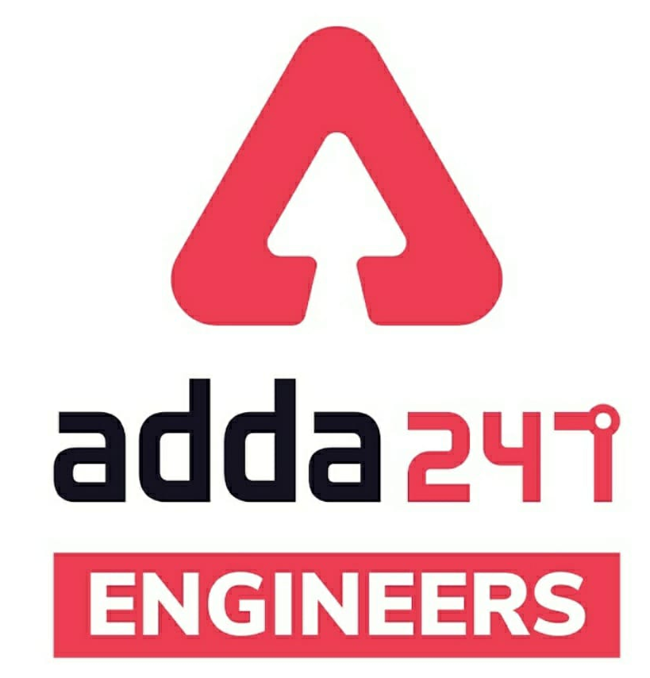
JSSC JE Exam 2023 | Mechanical Engineering | Most Expected Questions
Mechanical Soormas
Nivas Gupta
Anuj Kanoujiya
Ajit Singh
Pragya Srivastava
Ravi Raj
Lokesh Varwan
Subir
Anchal Mishra
Dilip Gupta
Pankaj Mahato
Ajay Kumar
Shivani Singh
MS D2E
Kritika Mall
Ruby Prajapati
Nitish Kumar
Amar Jyoti
Sandeep Kumar Jha
Ajaya Suna
Aashik Hussain
Raj Yadav
Shri Krishna
Rpiyanshu Kushwaha
Mohit Kumar
Naveen Manariya
Amit Kumar
Warif
Ayush Suthar
for
Code : “Y166”

Slide 5
JSSC JE Exam 2023 | Mechanical Engineering | Most Expected Questions
Mechanical Soormas
Ankit Mongre
Naresh Kumar
Vikas Dev Pandey
Mona Singh
Neeraj Rathor
Shahzad Ali
Nandan Mehta
Alok Kumar
Ela Sahoo
Manadeep
Aman Kumar
Rajat Bobde
Sabita Das
Ashish Kumar
Mohit Kumar
Ravi Singh
Rajesh Rohilla
Satyendra Kumar
Sahid Ahmed
Rupam Kumari
Jignesh Shah
Mohit Kashyap
Chandan Kumar Raj
Shubhi Tiwari
Sahil Prajapati
Vaibhav Srivastava
for
Code : “Y166”

Slide 6
JSSC JE 2023 | Mechanical Engineers | Most Expected QuestionsSet-3
Mechanical Engineering
For 78% Discount
Use Code : “Y166”
For Complete theory and concepts join our Mahapack Batch, Use Code Y166 For 78% of Discount

Slide 7
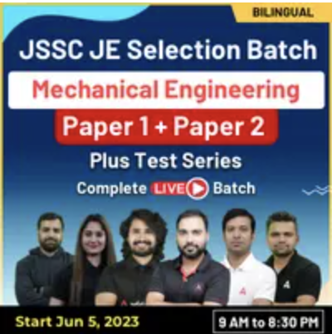
JSSC JE 2023 | Mechanical Engineers | Most Expected QuestionsSet-3
Mechanical Engineering
For 78% Discount
Use Code : “Y166”
Course Highlights
350+ hours of Live Technical Classes
130+ hours of Live Non-Technical Classes
Access to Recorded Videos
Latest Pattern of JSSC JE
Question Practice Session
For Complete theory and concepts join our Mahapack Batch, Use Code Y166 For 78% of Discount

Slide 8
JSSC JE 2023 | Mechanical Engineers | Most Expected QuestionsSet-7
Mechanical Engineering
Q. The cross section of cippoletti weir is_
A. rectangular
B. triangular
C. trapezoidal
D. None of these
For 78% Discount
Use Code : “Y166”
For Complete theory and concepts join our Mahapack Batch, Use Code Y166 For 78% of Discount

Slide 9
JSSC JE 2023 | Mechanical Engineers | Most Expected QuestionsSet-7
Mechanical Engineering
Q. When there is no air left below the nappe, it is know as _
A. free nappe
B. depressed nappe
C. adhering nappe
D. all option are correct
For 78% Discount
Use Code : “Y166”
For Complete theory and concepts join our Mahapack Batch, Use Code Y166 For 78% of Discount

Slide 10
JSSC JE 2023 | Mechanical Engineers | Most Expected QuestionsSet-7
Mechanical Engineering
Q. A notch is a device used for measuring_
A. rate of flow through a pipe
B. flow velocity through a small channel
C. rate of flow through a small channel
D. flow velocity through a pipeline
For 78% Discount
Use Code : “Y166”
For Complete theory and concepts join our Mahapack Batch, Use Code Y166 For 78% of Discount

Slide 11
JSSC JE 2023 | Mechanical Engineers | Most Expected QuestionsSet-7
Mechanical Engineering
Q. If the Froude Number in Open Channel Flow is Less than 1 then the flow is called _
Critical Flow
Super Critical Flow
Sub Critical Flow
None Of the above
For 78% Discount
Use Code : “Y166”
For Complete theory and concepts join our Mahapack Batch, Use Code Y166 For 78% of Discount

Slide 12
JSSC JE 2023 | Mechanical Engineers | Most Expected QuestionsSet-7
Mechanical Engineering
Q. The region between the separation streamline and the boundary surface of the solid body is known as !
A. Crest
B. drag
C. lift
D. boundary layer
For 78% Discount
Use Code : “Y166”
For Complete theory and concepts join our Mahapack Batch, Use Code Y166 For 78% of Discount

Slide 13
JSSC JE 2023 | Mechanical Engineers | Most Expected QuestionsSet-7
Mechanical Engineering
Q. In the polytropic process equation PVn = constant if n is infinitesimally small, the process is termed as-
Constant volume
(b) Constant pressure
(c) Constant temperature
(d) Adiabatic
For 78% Discount
Use Code : “Y166”
For Complete theory and concepts join our Mahapack Batch, Use Code Y166 For 78% of Discount

Slide 14
JSSC JE 2023 | Mechanical Engineers | Most Expected QuestionsSet-7
Mechanical Engineering
Q. Heat transfer takes place as per the law of !
Zeroth Law of Thermodynamics
(b) First Law of Thermodynamics
(c) Law of Conduction
(d) None of the above
For 78% Discount
Use Code : “Y166”
For Complete theory and concepts join our Mahapack Batch, Use Code Y166 For 78% of Discount

Slide 15
JSSC JE 2023 | Mechanical Engineers | Most Expected QuestionsSet-7
Mechanical Engineering
Q. Identify open system and closed system from the following!
(a) Blood circulation and respiration in human body
(b) Fuel system and radiator in cars
(c) Boiler and Air compressor
(d) None of the above
For 78% Discount
Use Code : “Y166”
For Complete theory and concepts join our Mahapack Batch, Use Code Y166 For 78% of Discount

Slide 16
JSSC JE 2023 | Mechanical Engineers | Most Expected QuestionsSet-7
Mechanical Engineering
Q. Compression efficiency is compared against!
(a) Ideal compression
(b) Adiabatic compression
(c) Isentropic compression
(d) Isothermal compression
For 78% Discount
Use Code : “Y166”
For Complete theory and concepts join our Mahapack Batch, Use Code Y166 For 78% of Discount

Slide 17
JSSC JE 2023 | Mechanical Engineers | Most Expected QuestionsSet-7
Mechanical Engineering
Q. The equation PV = mRT is essentially valid for.
(a) Perfect gas
(c) Monoatomic gas
(b) Real gas
(d) Mixture of gases
For 78% Discount
Use Code : “Y166”
For Complete theory and concepts join our Mahapack Batch, Use Code Y166 For 78% of Discount

Slide 18
JSSC JE 2023 | Mechanical Engineers | Most Expected QuestionsSet-7
Mechanical Engineering
Q. The piston rod and the cross head in a steam engine are usually connected by means Of.
Cotter Joint
Knuckle Joint
Universal Joint
Ball Joint
For 78% Discount
Use Code : “Y166”
For Complete theory and concepts join our Mahapack Batch, Use Code Y166 For 78% of Discount

Slide 19
JSSC JE 2023 | Mechanical Engineers | Most Expected QuestionsSet-7
Mechanical Engineering
Q. Hollow shafts are stronger than solid shafts having same weight because-
(a) the stiffness of hollow shaft is less than that of solid shaft
(b) the strength of hollow shaft is more than that of solid shaft
(c) the natural frequency of hollow shaft is less than that of solid shaft
(d) in hollow shafts, material is not spread at large radius
For 78% Discount
Use Code : “Y166”
For Complete theory and concepts join our Mahapack Batch, Use Code Y166 For 78% of Discount

Slide 20
JSSC JE 2023 | Mechanical Engineers | Most Expected QuestionsSet-7
Mechanical Engineering
Q. In Hero cycle which type of joint used- ?
Cotter joint
(b) Knuckle joint
(c) Gib and cotter joint
(d) Rivetted joint
For 78% Discount
Use Code : “Y166”
For Complete theory and concepts join our Mahapack Batch, Use Code Y166 For 78% of Discount

Slide 21
2023 AE/JE Aspirants | List of all upcoming Vacancies | By Shivam Sir
For Complete theory and concepts join our Mahapack Batch, Use Code Y166 For 78% of Discount

Slide 22
2023 AE/JE Aspirants | List of all upcoming Vacancies | By Shivam Sir
For Complete theory and concepts join our Mahapack Batch, Use Code Y166 For 78% of Discount

Slide 23
JSSC JE 2023 | Mechanical Engineers | Most Expected QuestionsSet-6
Mechanical Engineering
HW. Which one of the following is correct relation between (COP)_{HP} and (COP)_{R.}
(COP)_{HP} –(COP)_{R} =1
(COP)_{R} –(COP)_{HP} =1
(COP)_{HP} +(COP)_{R} =1
(COP)_{HP} +(COP)_{R} =1
For 78% Discount
Use Code : “Y166”
For Complete theory and concepts join our Mahapack Batch, Use Code Y166 For 78% of Discount

