Slide 3
Most Important Essay Topics
PRISON REFORMS

Slide 4
Ministry of Home Affairs (MHA) issued guidelines for implementation of the Modernisation of Prisons (MoP) Project.

Slide 5
Background
• Prison is a State subject under List-II of the Seventh Schedule in the Constitution.
• The management and administration of Prisons falls exclusively in the domain of the State Governments, and is governed by the Prisons Act, 1894 and the Prison Manuals of the respective State Governments.
• However, the Ministry of Home Affairs provides regular guidance and advice to States and UTs on various issues concerning prisons and prison inmates.

Slide 6
About Modernisation of Prisons (MoP) Project
• Government of India has decided to provide financial assistance (in form of Grant in aid) to States and UTs, through MoP for using modern-day security equipment in Prisons for
o Enhancing the security of jails and
o To facilitate the task of reformation and rehabilitation of prisoners through correctional administration programmes.
• Duration of the project is for five years 2021-26

Slide 7
Objectives of MoP project
o Filling the existing gaps in security infrastructure of jails.
o Providing new security equipment to jails in line with modern day technologies.
o Strengthening the jail security system through security equipment like Door Frame/ Metal Detectors/ Security Poles, Baggage Scanners/ Frisking/ Search/ Jamming Solutions etc.
o Focus on correctional administration, which includes bringing attitudinal change in the mindset of prison officials handling inmates.

Slide 8
• Project will cover all States and UTs and shall broadly cover the following prison types- Central Jails, District Jails, Sub-Jails, Women Jails, Open Jails, Special Jails etc.
• Core components of MoP project are video conference infrastructure, body worn cameras, door frame/Metal detector/Security Poles etc., Baggage Scanners/ Frisking/ Search/ Jamming Solutions etc, correctional programmes etc.

Slide 9
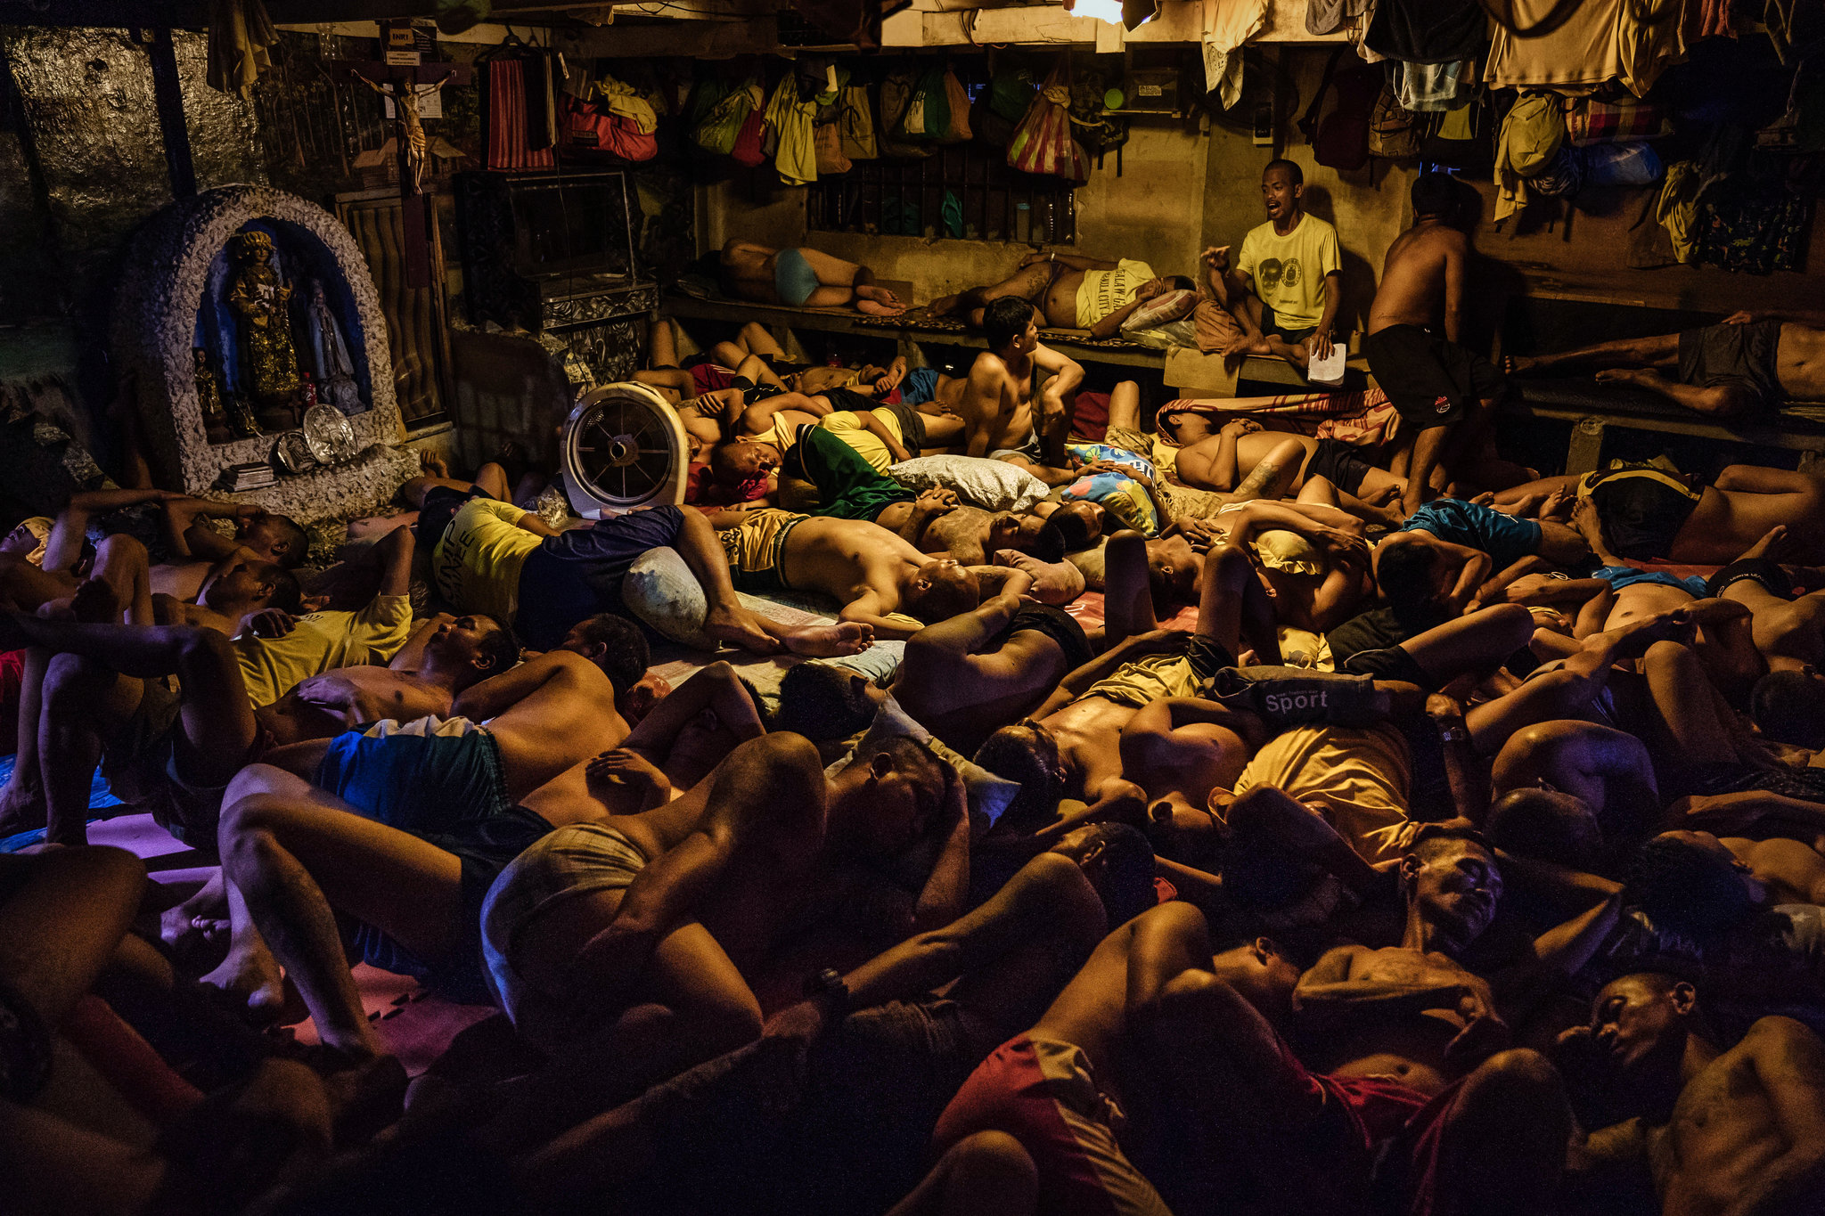
Need for Prison Reforms
• Overcrowding:
“Prison Statistics India”, brought out by National Crime Records Bureau stated that in 2019, there were nearly 4.8 lakh inmates in 1,306 facilities against the sanctioned strength of 4.1 lakh, with an occupancy rate of 118%.

Slide 10
Need for Prison Reforms
o This undermines the ability of prison systems to meet the basic needs of prisoners, such as healthcare, food, and accommodation.
o This also endangers the basic rights of prisoners, including the right to have adequate standards of living and the right to the highest attainable standards of physical and mental health.

Slide 11
• No separation of under-trials: Around 75% of inmates in our jails are under-trials. As these awaiting trial inmates come into touch with their incarcerated inmates, they get influenced into the world of crime.
• Health consequences of imprisonment: Prisoners health conditions deteriorate in prisons which are overcrowded, where nutrition is poor, sanitation inadequate and access to fresh air and exercise often unavailable.

Slide 12
• Imprisonment and poverty: Imprisonment contributes directly to the impoverishment of the prisoner, of his family.
Family experiences financial losses as a result of the imprisonment of one of its members, exacerbated by the new expenses that must be met -such as the cost of a lawyer, food for the imprisoned person, transport to prison for visits and so on.
• Severe staff crunch: About 30% of the sanctioned jail executive staff posts still lie vacant. At national level there is an average 7 inmates per staff in all jails in India (2020).

Slide 13
• Issues of women prisoners: There is a severe lack of female staff, inadequate numbers of toilets, bathrooms and other basic preconditions for sanitation and hygiene. Also physical and sexual violence is a common scenario in prison.
• COVID-19 induced changes: Many prison systems have failed to implement critical COVID-19 preventive measures.
People in prison are especially vulnerable due to cramped living conditions, lack of hygiene supplies and poorer health status.

Slide 14
Important Reform Measures taken so far in India
• The modern prison system was conceptualised by TB Macaulay in 1835.
• Prison Act, 1894, enacted to bring uniformity in the working of the prisoners in India. The Act provided for classification of prisoners.
• All India Jail Committee (1919-1920) was first ever comprehensive study that was launched on this subject.
• All India Jails Manual Committee 1957-59 to prepare a model prison manual

Slide 15
Conclusion:
• Issue of overcrowding can be addressed by:
Open Jail
o It is a correctional institution in which inmates are trusted to serve out their sentences under limited supervision and are often not locked up in jails.
They are free to go to work and return to the jail after working hours.

Slide 16
o Fast-Track Courts: should be established so that no innocent prisoner should be forced to spend too much time in jail.
• Adherence to key international rules and standards such as:
o UN Standard Minimum Rules for the Treatment of Prisoners (the Nelson Mandela Rules) that set out the minimum standards for the treatment of people in prison and for good prison management.

